Slide 1
ICAME in CLARIN
- a software demo of Corpuscle
Knut Hofland
Uni Research Computing
Bergen, Norway
ICAME 35, Nottingham

Slide 2

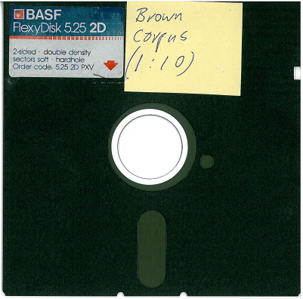
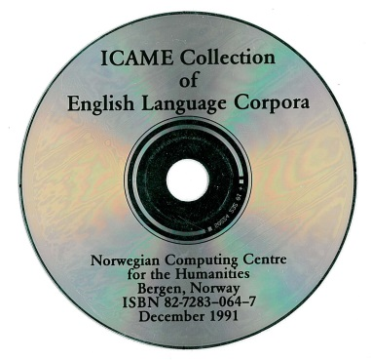
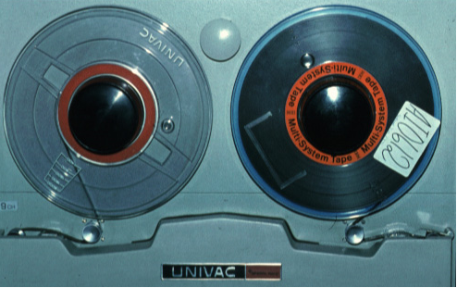
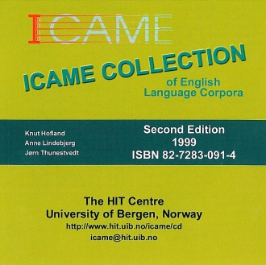
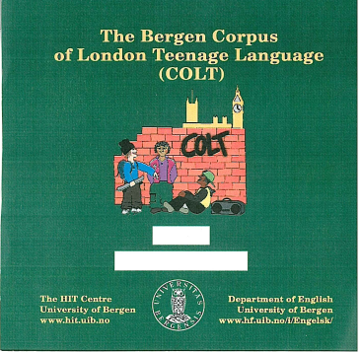
Icame.uib.no
established 1977 Bergen, clearinghouse data
tape, diskettes, CD, web-search, 1800 copies
21 corpora, Brown family, historical, spoken

Slide 3

Common Language Resources and Technology Infrastructure
Large EU project (clarin.eu) with national funding
A, B and C centres all over Europe
Meta data collection and search (VLO)
Authorization and authentication
Web servers and web services (also tool chaining)
Federated content search
Preservation
Sustainability

Slide 4
Corpuscle (clarino.uib.no/corpuscle)
Structured data, parallel corpora, aligned media
Large corpora (> 2 billion words)
Federated login (eduGAIN, OpenIdP)
CLARIN integration, metadata harvested, PID
Query, basic text & GUI / regular expression
Word lists, Concordance, Collocations
Searchable personal annotation
Distribution of statistics (by metadata/words/ann.)
Download of corpora and of results

Slide 5
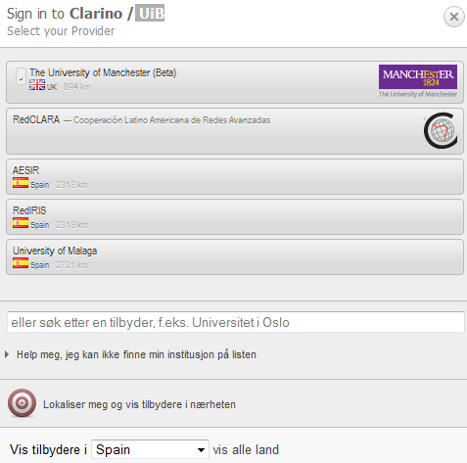
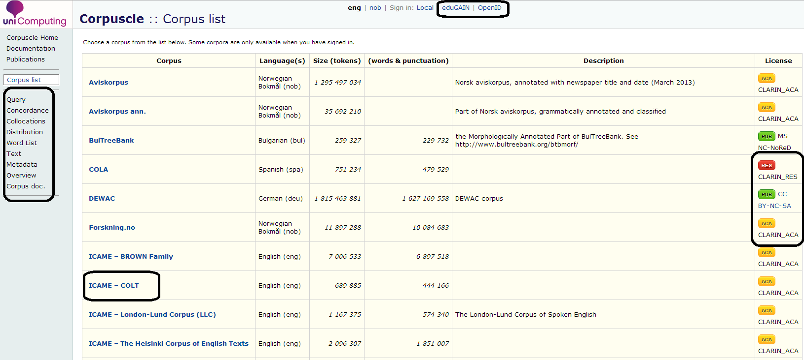
Corpus List

Slide 6
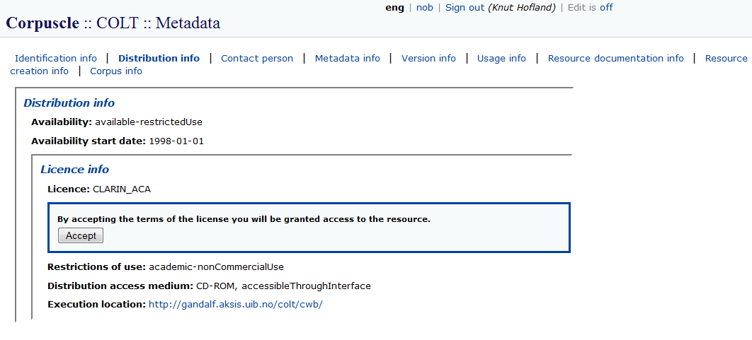
Accepting terms

Slide 7
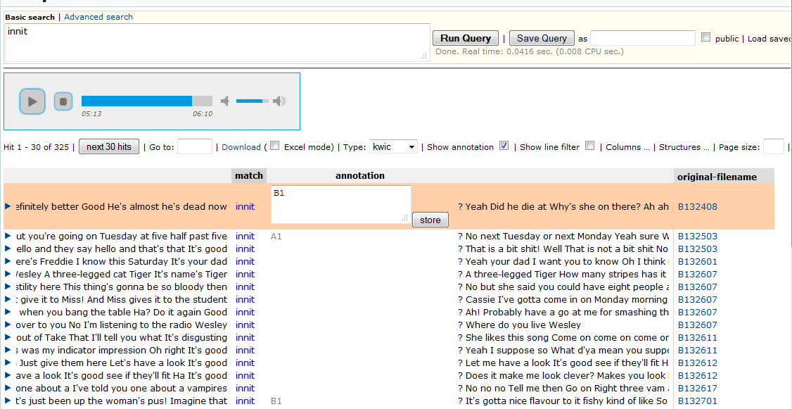

Query / concordance / media

Slide 8
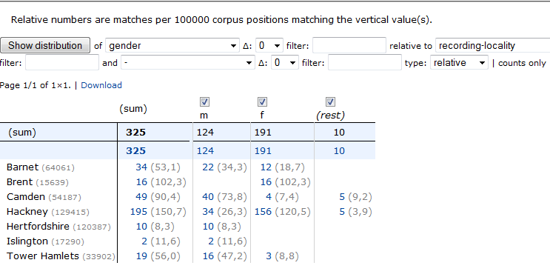
Distribution

Slide 9
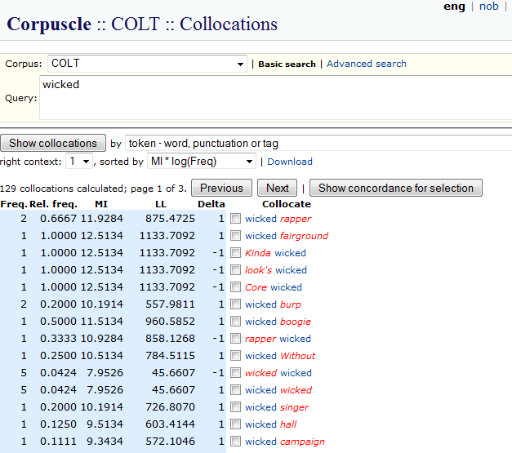
Collocations

Slide 10
More info
Leaflet
icame.uib.no/clarin
Live demo near Book Exhibition
Poster at demo room

