Slide 1
Corpuscle
Knut Hofland
Uni Research Computing
Bergen, Norway
http://clarino.uib.no/corpuscle
Workshop, ICAME 37, Hong Kong, 25.5.16

Slide 2
Corpuscle (clarino.uib.no/corpuscle)
Structured data, parallel corpora, aligned media
Large corpora (> 2 billion words)
Federated login (eduGAIN, OpenIdP, CLARIN)
CLARIN integration, metadata harvested, PID
Query, basic text & GUI / regular expression
Word lists, Concordance, Collocations, media
Searchable personal annotation
Distribution of statistics (by metadata/words/ann.)
Download of corpora and of results
Upload of corpora, search API, federated search

Slide 3
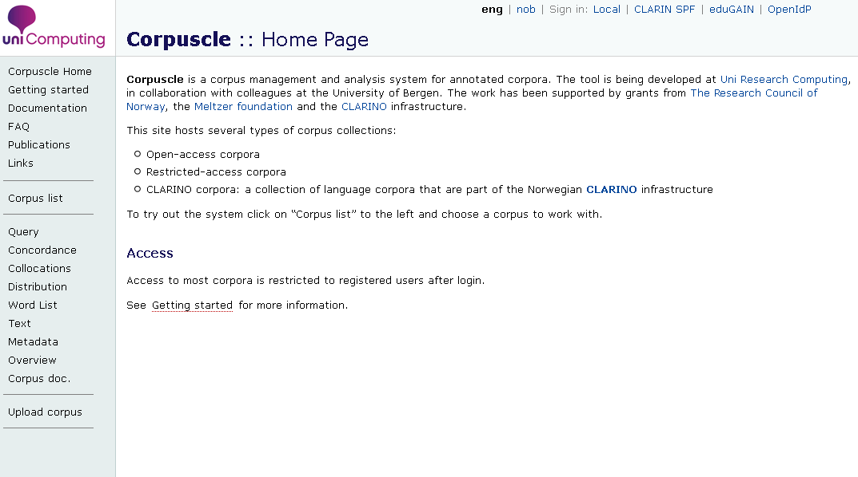

Slide 4

Corpuscle - login

Slide 5
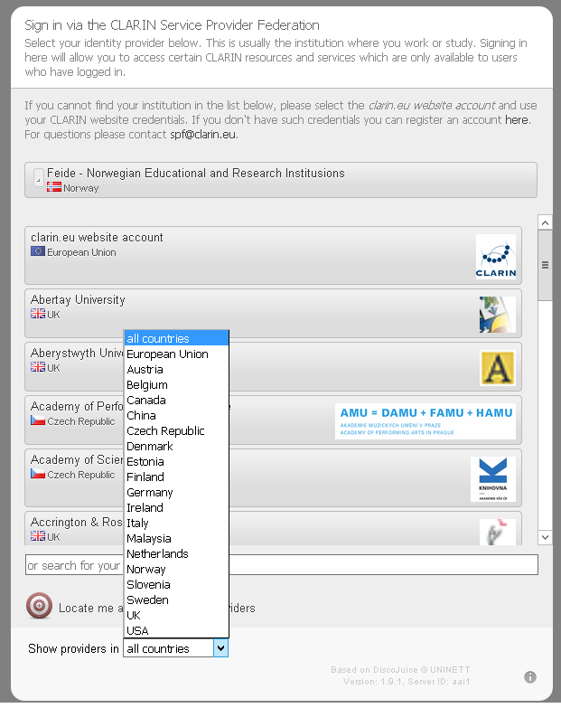
Corpuscle – login CLARIN SPF

Slide 6
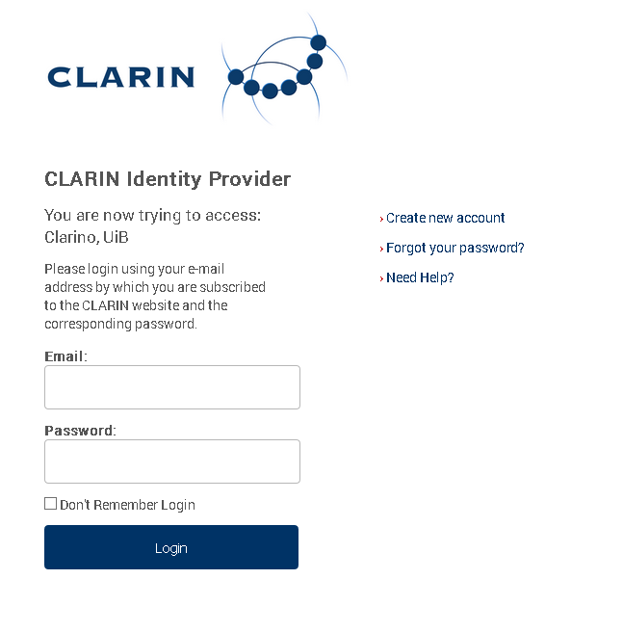
CLARIN - IdP

Slide 7
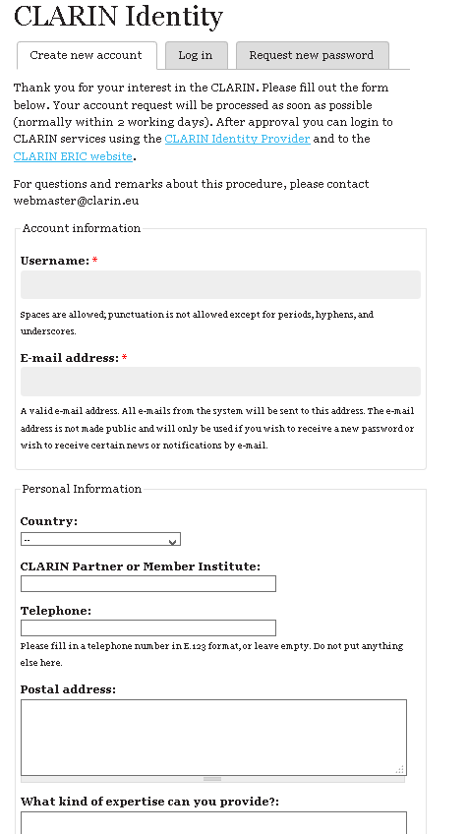

Slide 9
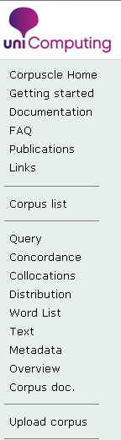
Corpuscle – main menu

Slide 10
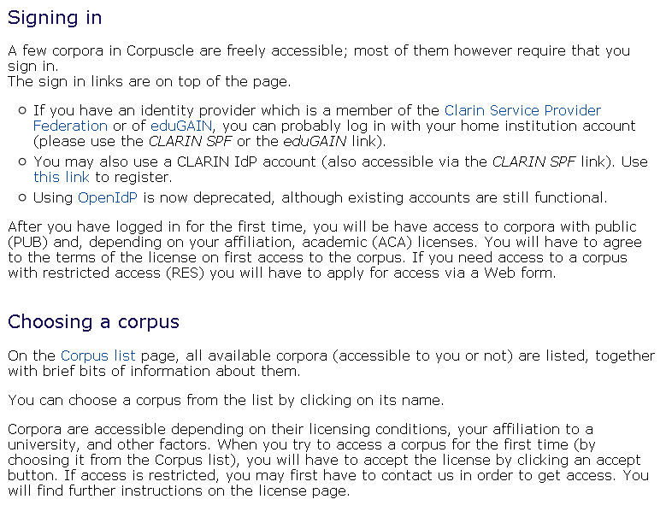

Slide 11
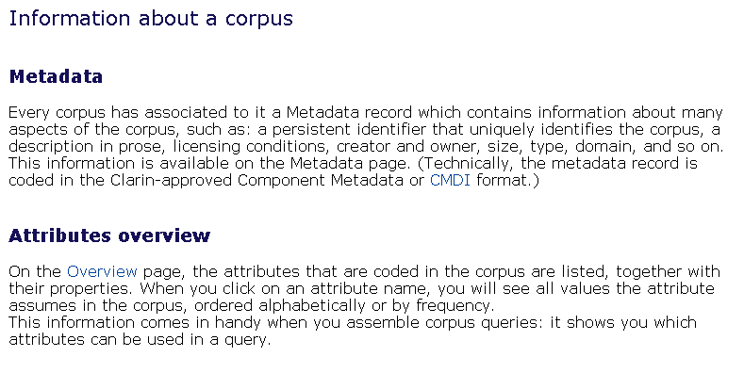

Slide 12
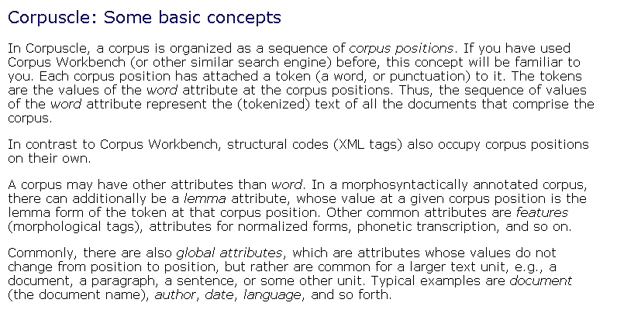

Slide 13
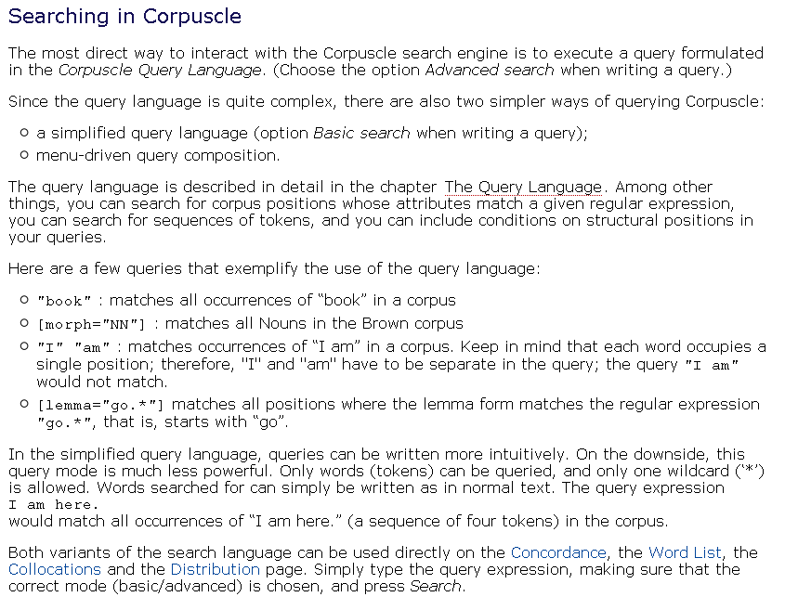

Slide 14
Corpuscle – main menu

Slide 15
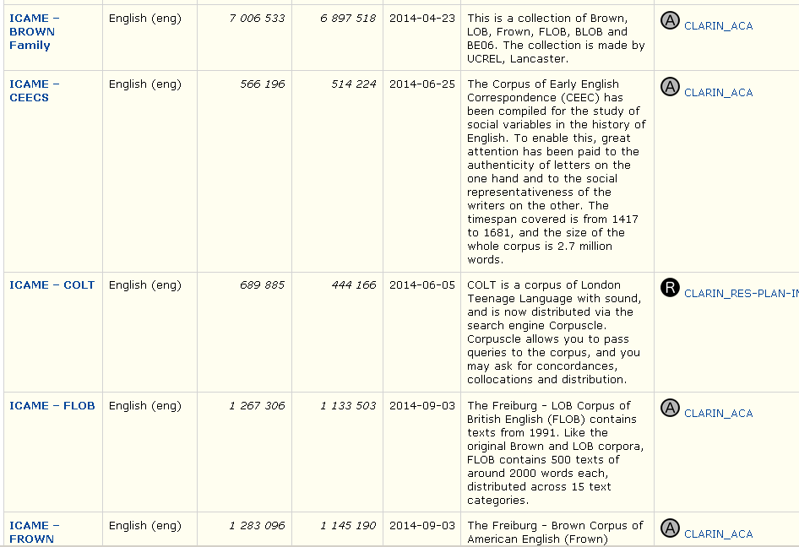

Slide 16
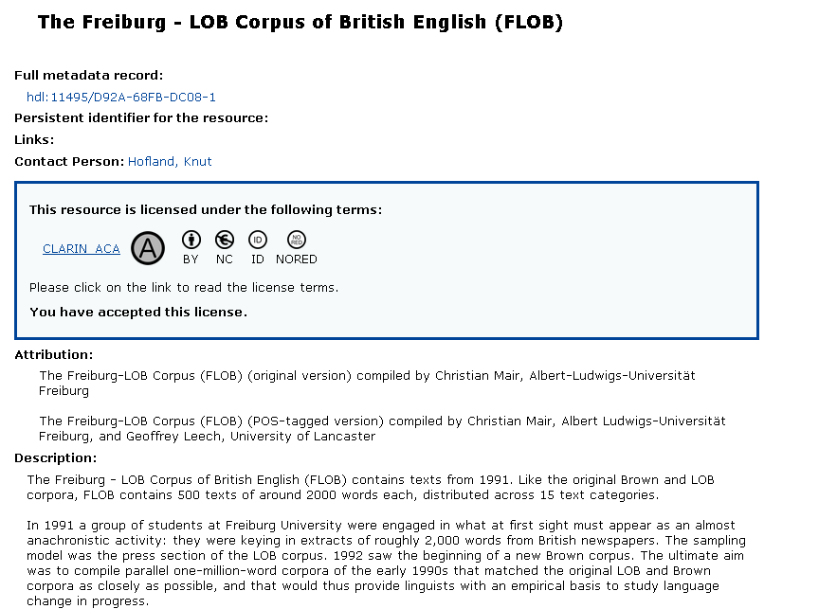

Slide 17
Corpuscle – main menu

Slide 18
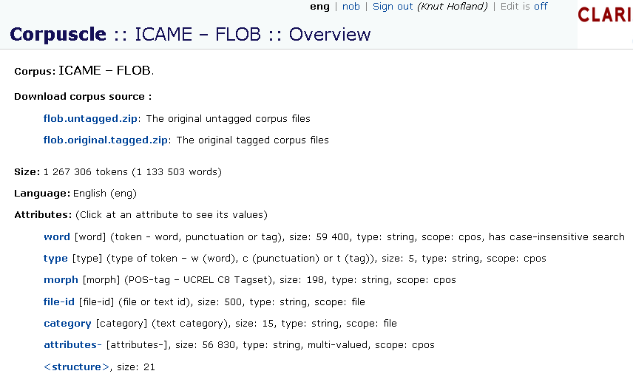

Slide 19
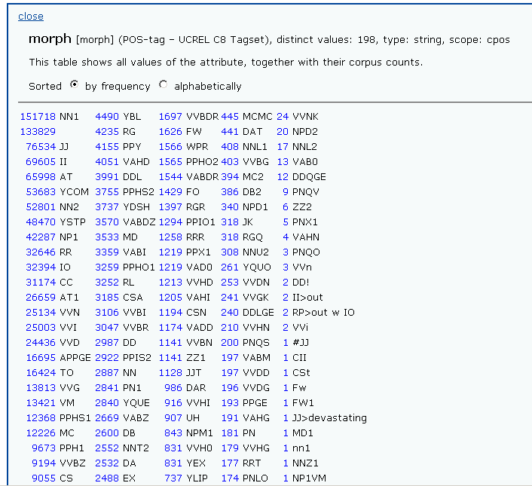

Slide 20
Corpuscle – main menu

Slide 21
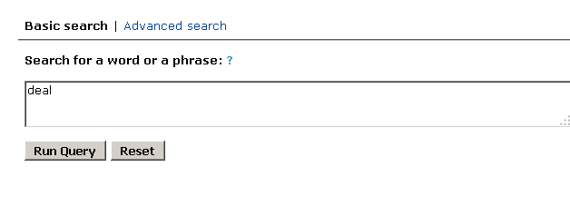
Corpuscle – basic search

Slide 22
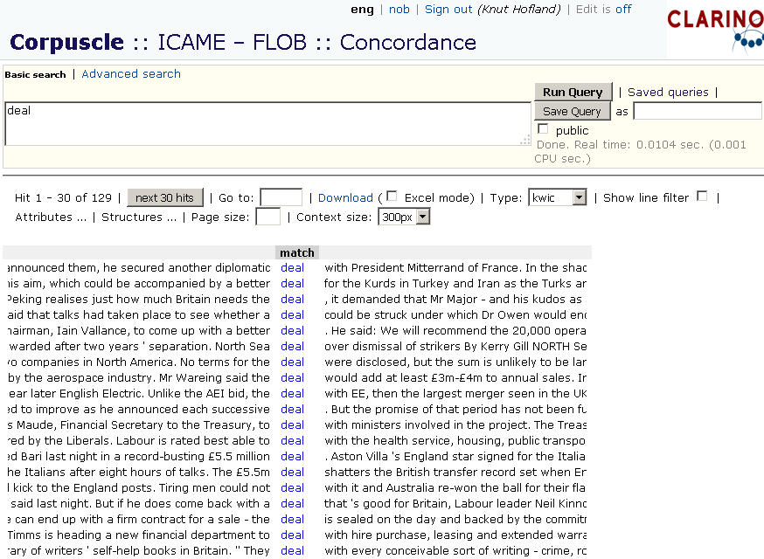

Slide 23
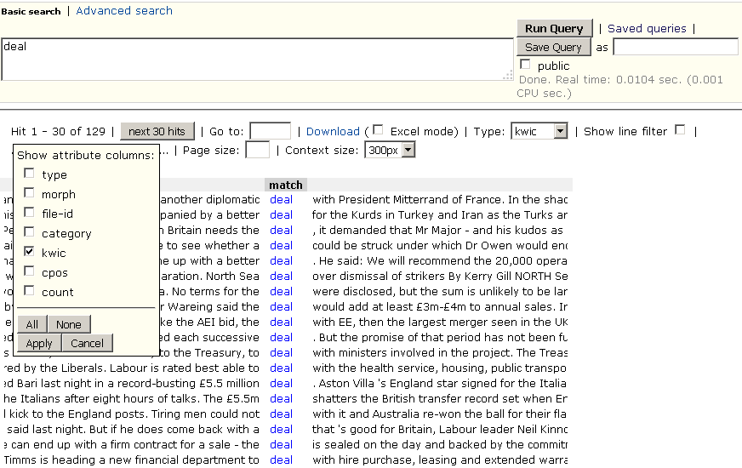

Slide 24
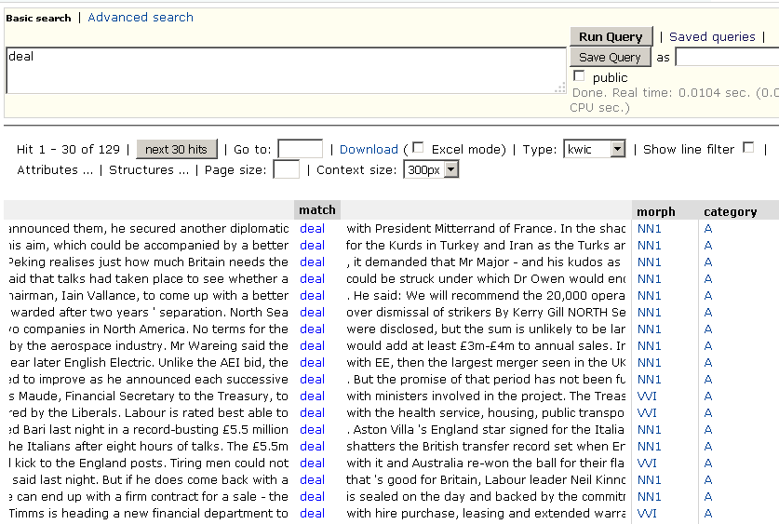

Slide 25
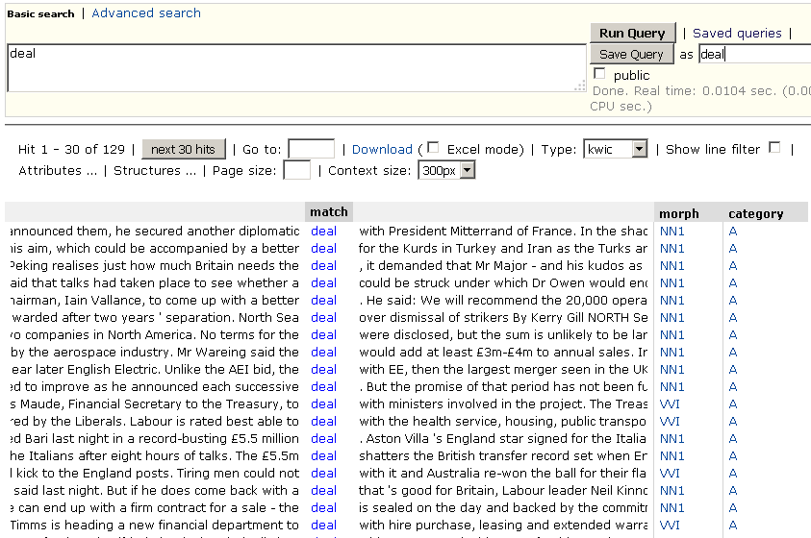

Slide 26
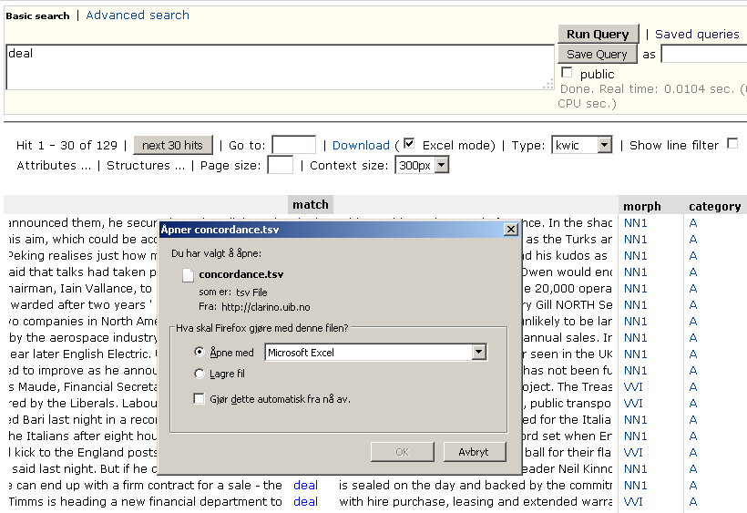

Slide 27
Corpuscle – main menu

Slide 28
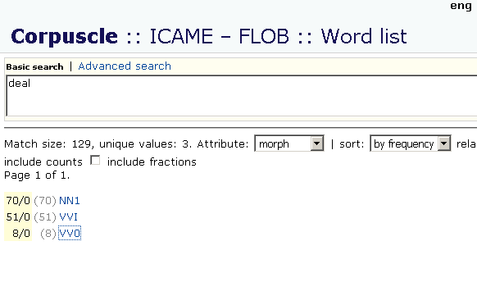

Slide 29
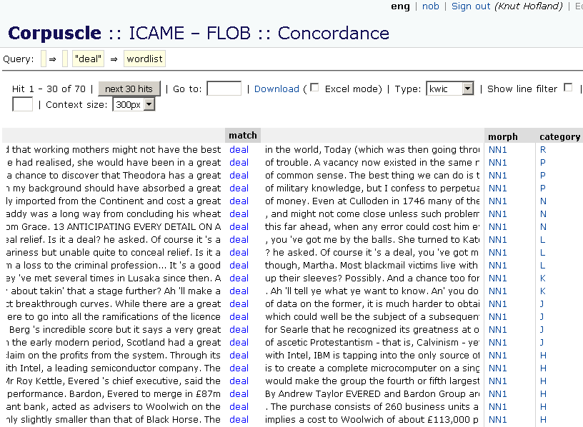

Slide 30
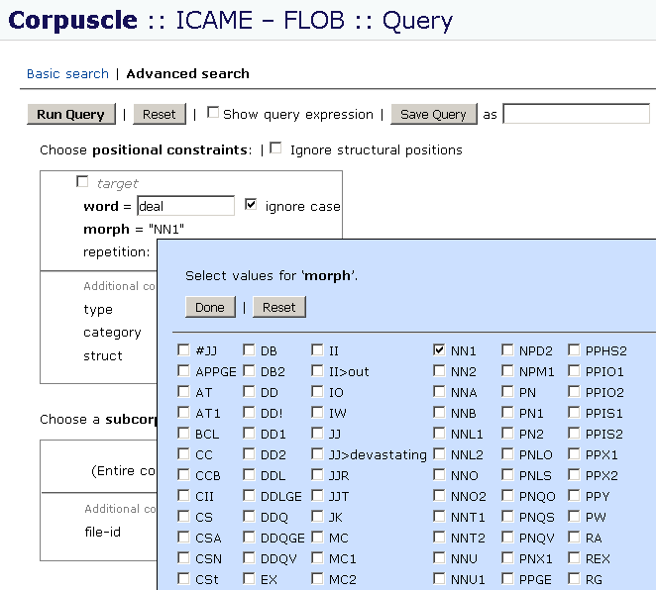

Slide 31
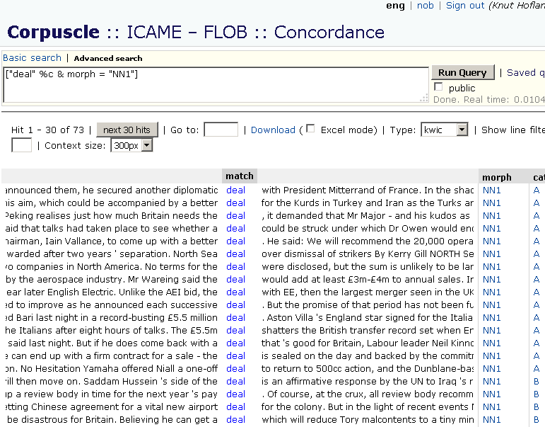

Slide 32
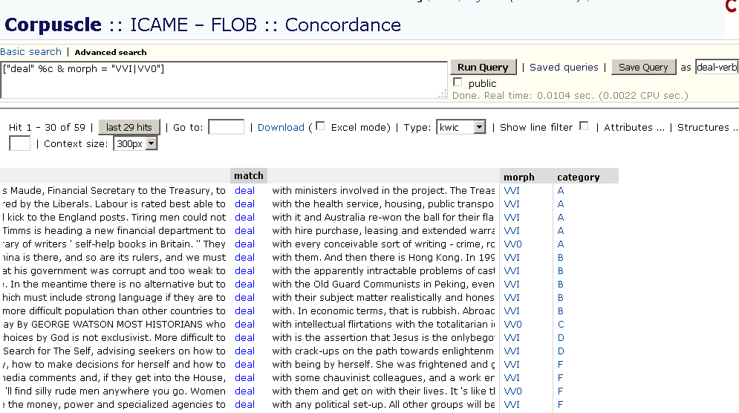

Slide 33
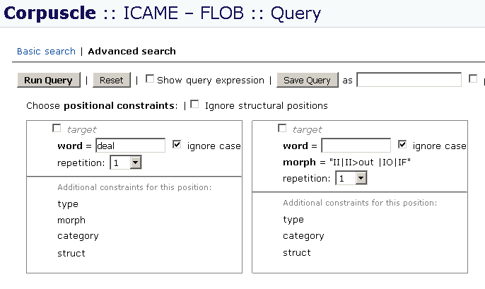

Slide 34
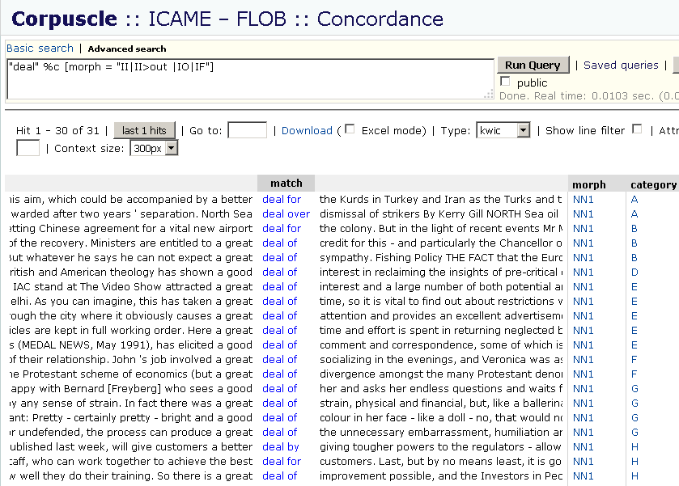

Slide 35
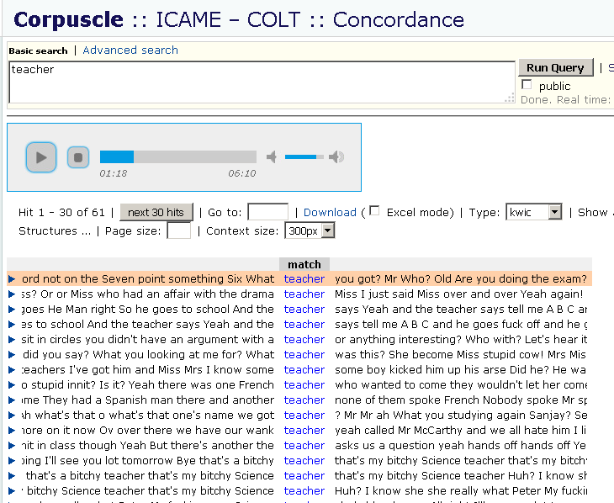

Slide 36
Corpuscle – main menu

Slide 37
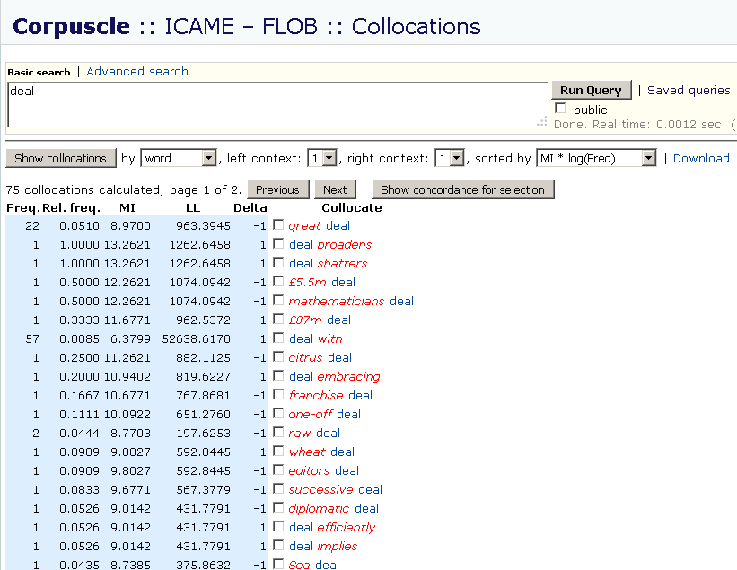

Slide 38
Corpuscle – main menu

Slide 39
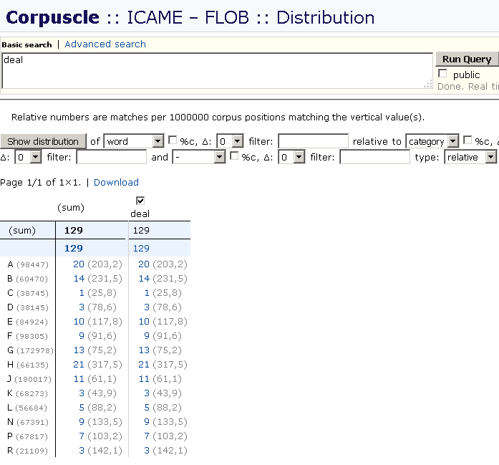

Slide 40
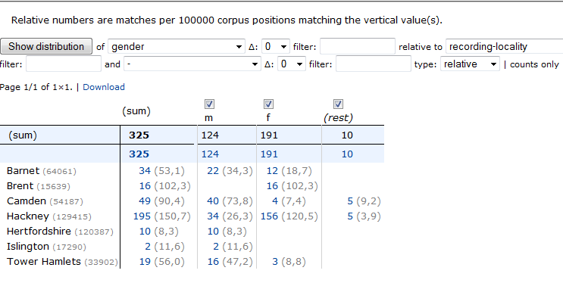
Distribution

Slide 41
Corpuscle – main menu

Slide 42
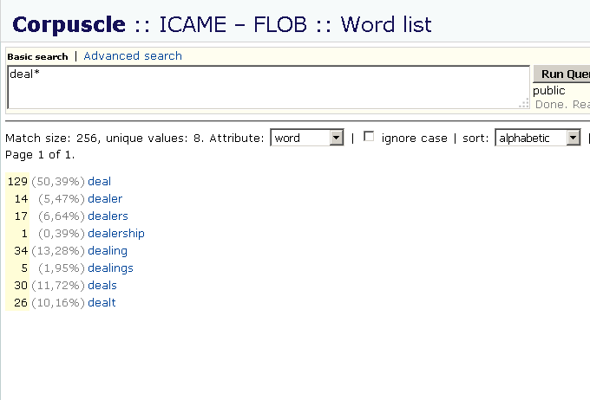

Slide 43
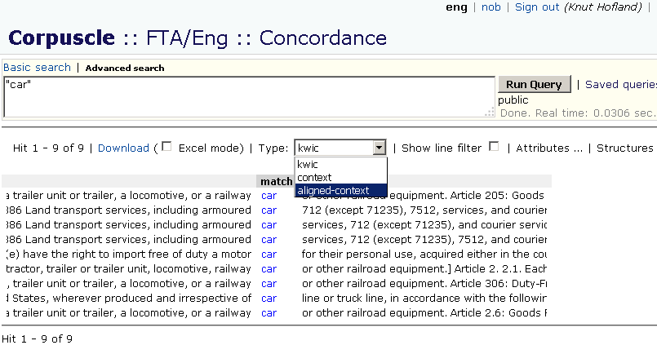

Slide 44
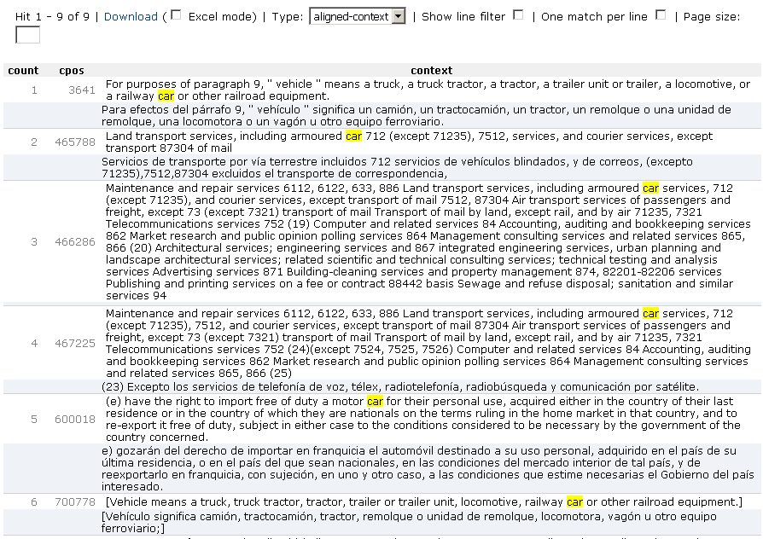

Slide 45
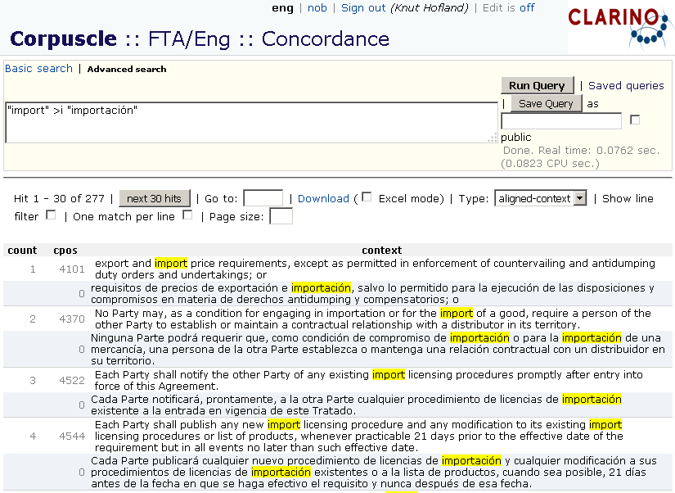

Slide 46
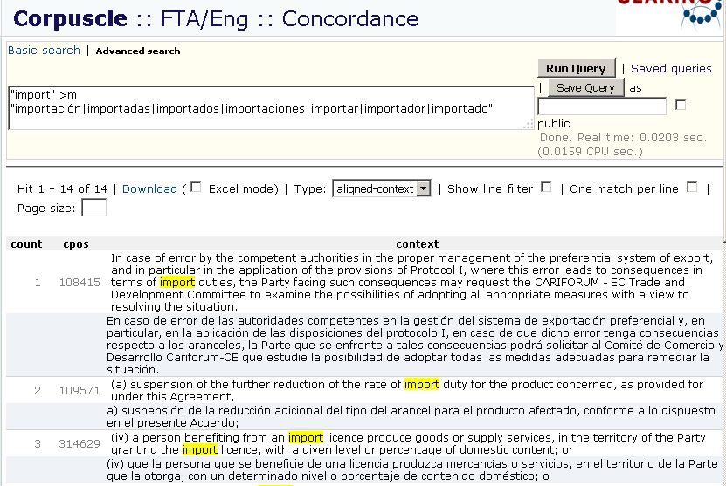

Slide 47
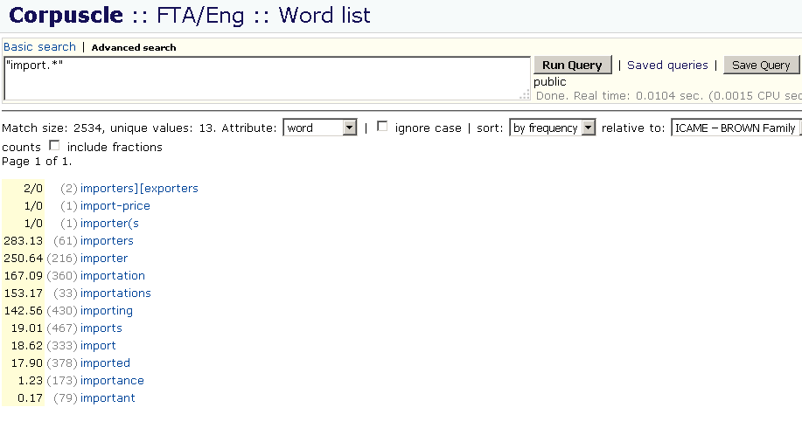

Slide 48
Corpuscle – main menu

Slide 49
clarino.uib.no/corpuscle

