Slide 1
CLARIN and CLARINO resources
Knut Hofland
Uni Research Computing
Bergen, Norway
http://clarino.uib.no
Workshop ICAME 37, Hong Kong, 23.05.16

Slide 2

clarin.eu

Slide 3
European Research Infrastructure Community (ERIC)
International legal entity
Consortium of countries and intergovermental organisations
Countries have national consortia with partners
Austria
Bulgaria
Czech Republic
Denmark
Dutch Language Union
Estonia
Finland
Germany
Greece
Italy
Lithuania
Netherlands
Norway
Poland
Portugal
Slovenia
Sweden
United Kingdom (observer)

Slide 4
CLARIN
provides easy and sustainable access for scholars in the humanities and social sciences
digital language data (in written, spoken, or multimodal form)
advanced tools interoperable with data
networked federation
  language data repositories
  service centres
  knowledge centres
persistent identifiers
single sign-on access for the academic community

Slide 5
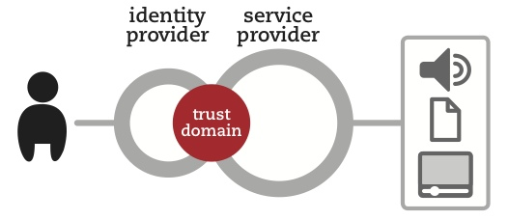
Federated identity
Federation of national identity providers (CLARIN SPF and eduGAIN)
CLARIN Identity provider

Slide 6
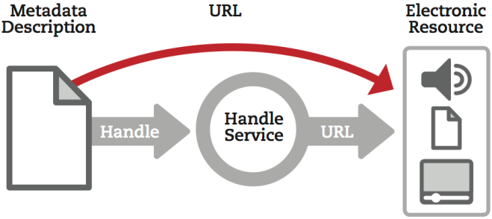
Persistent identifiers

Slide 7
Metadata
Structured description of data
CMDI (Component MetaData Infrastructure)
Components grouped into profiles
Stored in component register (for reuse)
Use concept register
Harvested into national and international databases

Slide 8
Licences
CLARIN terms of Service (general conditions)
Special conditions
  CLARIN public licences (PUB)
  CLARIN academic licences (ACA)
  CLARIN restricted licences (RES)
Deposition Licence Agreements
End User Licence Agreements

Slide 9
Centres
B centres, metadata and services
C centres, metadata
K centres, knowledge
E centres, external

Slide 10
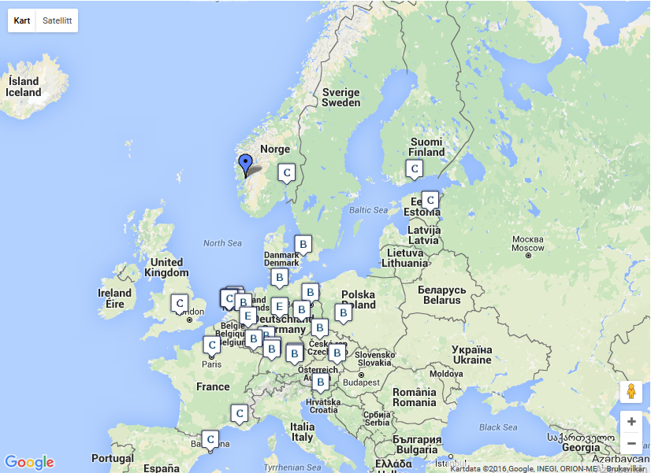

Slide 11
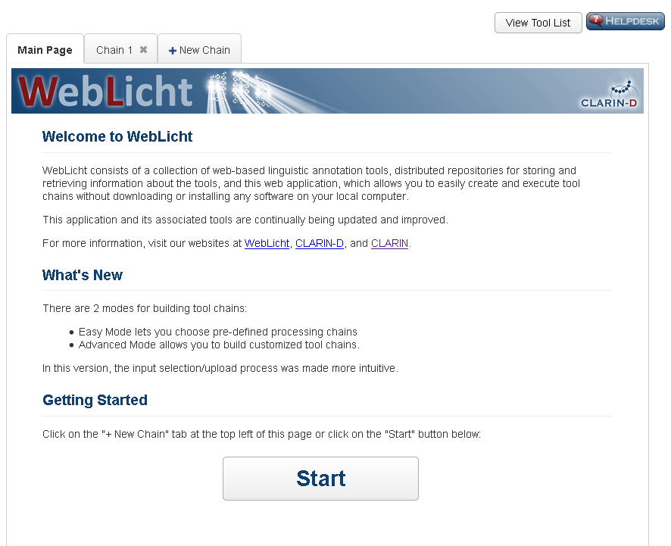

Slide 12
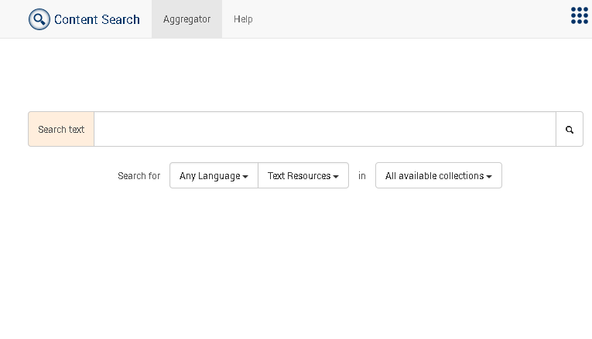
Federated content search
From one user interface search at the same time in many text collections at different centres

Slide 13
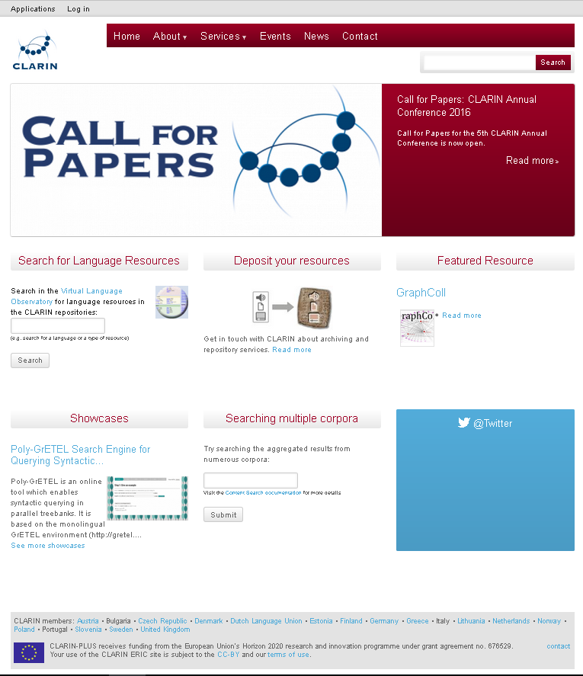

Slide 14
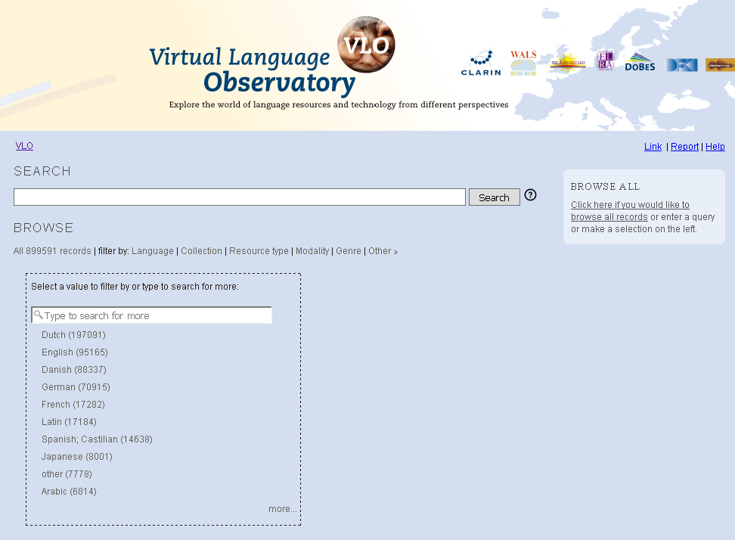

Slide 15
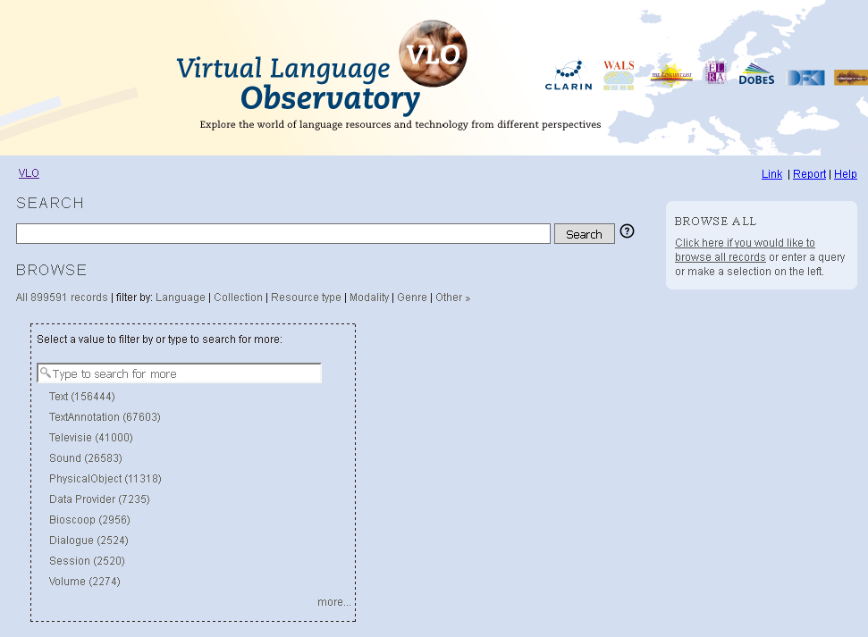

Slide 16


Slide 17
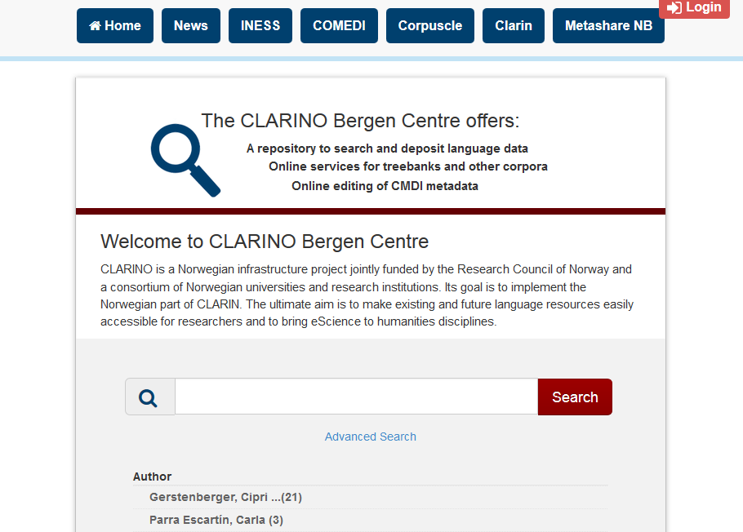
CLARINO

Slide 18
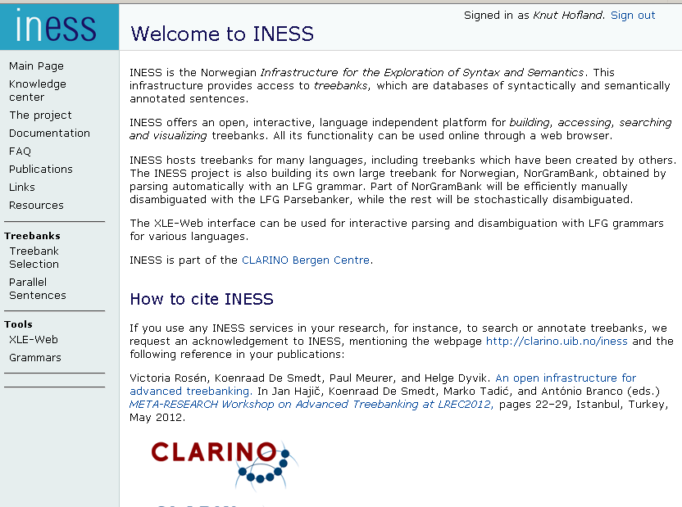

Slide 19
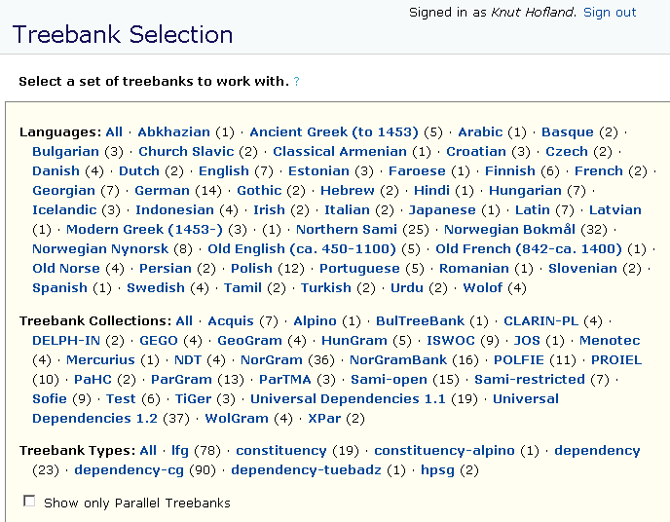

Slide 20
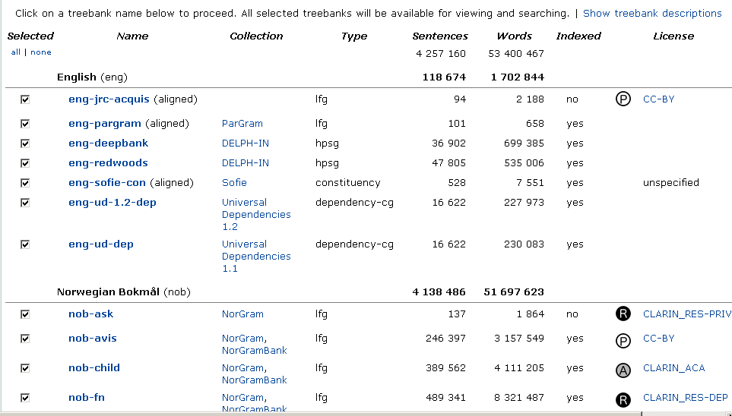

Slide 21
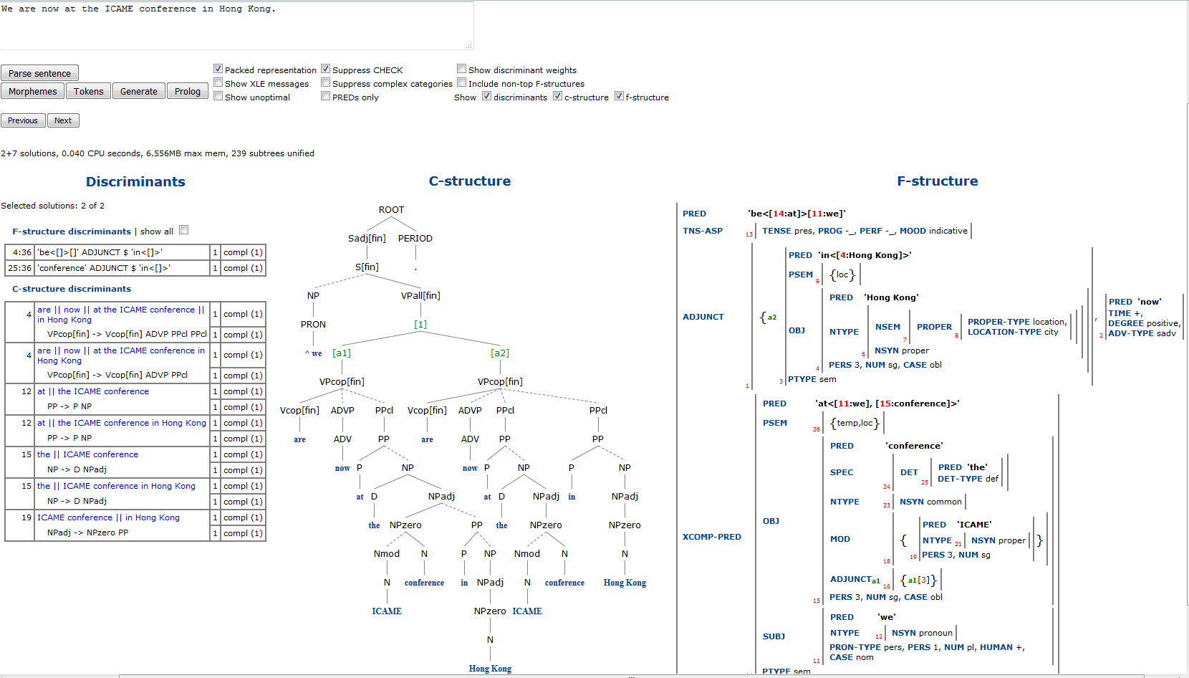
INESS

Slide 22
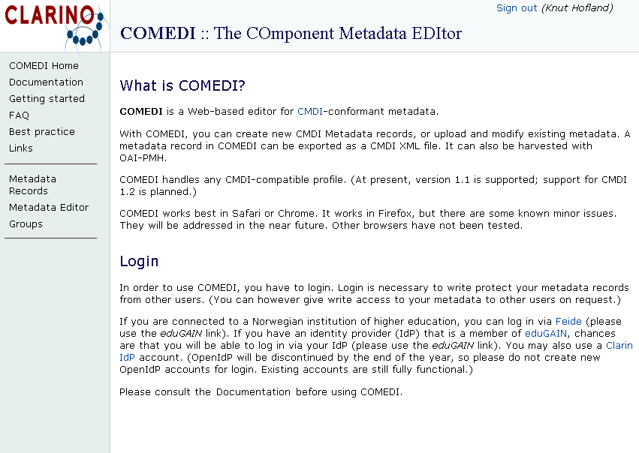
COMEDI

Slide 23

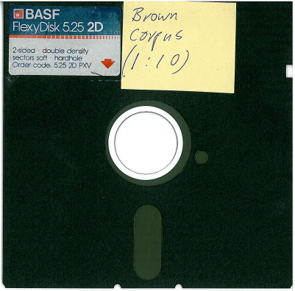
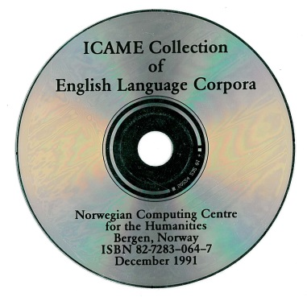
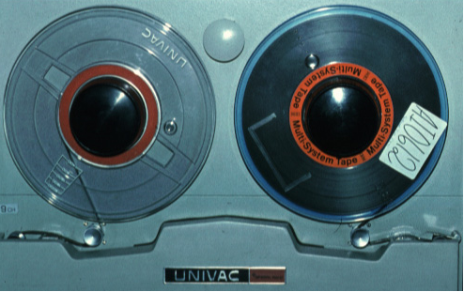
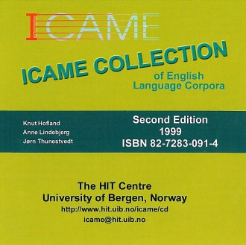
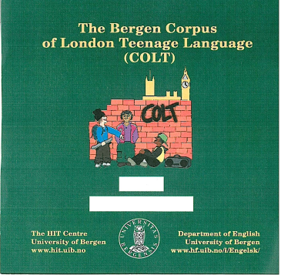
Icame.uib.no
established 1977 Bergen, clearinghouse data
tape, diskettes, CD, web-search, 1800 copies
21 corpora, Brown family, historical, spoken

Slide 24
ICAME Corpora in CLARINO
Australian Corpus of English (ACE)
Brown family ( F)Brown, (F)LOB, BLOB, BE06
Helsinki Corpus
Helsinki Corpus of Older Scots
Corpus of Early English Correspondance sampler
Corpus of London Tenage Language (COLT)
London-Lund Corpus
LOB, FLOB and Frown in orig. tagging

Slide 25
Other Corpora
KIAP, Academic prose, economics, linguistics, medicine, Norwegian, French, English, 450 articles, 3.1 mill. words
FTA, Free Trade Agreements, Latin America, parallel corpus English-Spanish, 2.8 mill. words
CORYL, Young learner English corpus, 7th, 10th, 11th grade, error tagged, assigned levels on the CEFR, 120k words
NTAP corpus, blogs within domain climate change
English-Lithuanian Parallel corpus, 13 mill. words
COLA (Corpus Oral de Lenguaje Adolescente), Spanish parallel to COLT, with sound
ASK, learner corpus Norwegian, error tagged
Norwegian newspaper corpus > 1000 mill. words

Slide 26
http://icame.uib.no/clarin/

